Slide 1
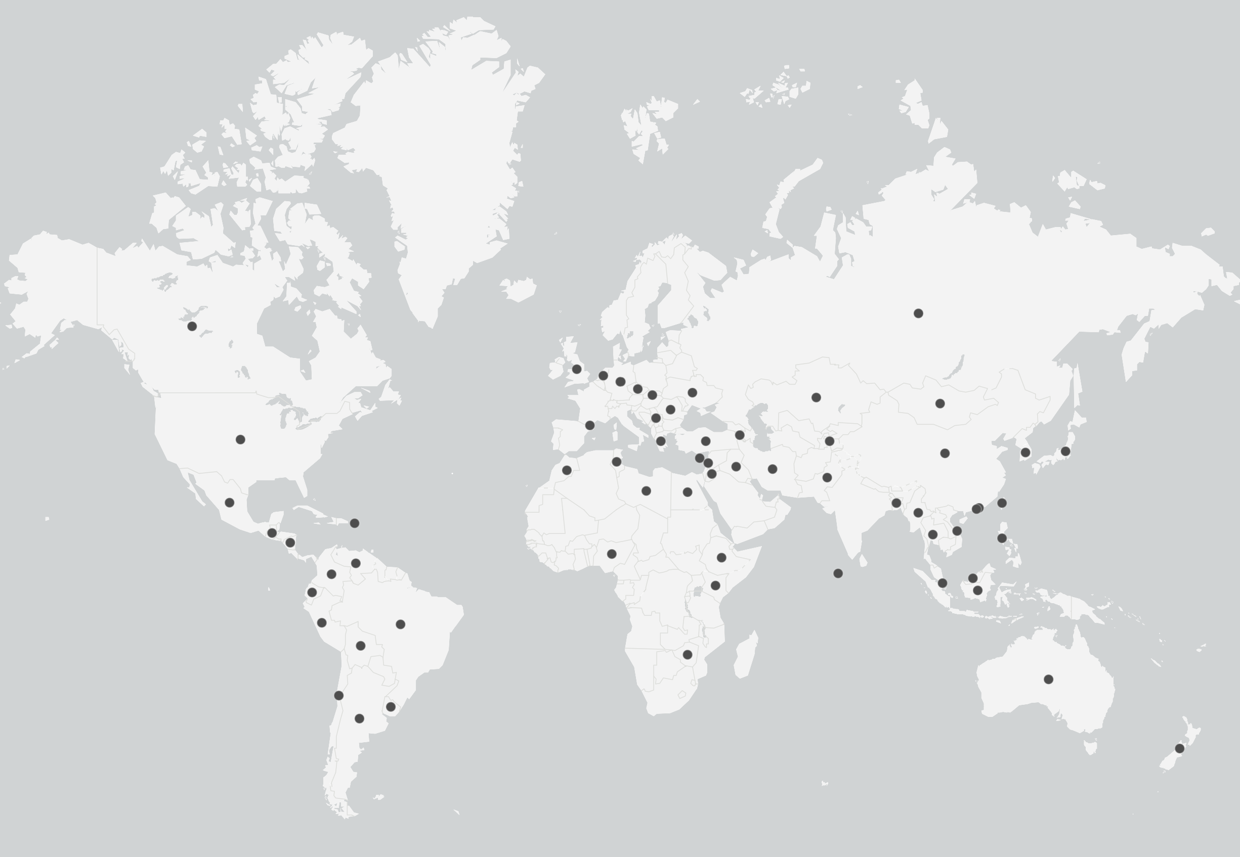
Netherlands
Russia
Canada
Germany
Slovakia
Northern Ireland
Czechia
Great Britain
Ukraine
Kazakhstan
Mongolia
Andorra
Romania
Kyrgyzstan
United States
Serbia
Turkey
Armenia
Greece
Tajikistan
China
South Korea
Japan
Morocco
Iraq
Iran
Pakistan
Mexico
Tunisia
Macao SAR
Hong Kong SAR
Libya
Egypt
Jordan
Bangladesh
Taiwan ROC
Guatemala
Puerto Rico
Cyprus
Lebanon
Myanmar
Thailand
Vietnam
Philippines
Nicaragua
Venezuela
Nigeria
Ethiopia
Columbia
Kenya
Maldives
Malaysia
Ecuador
Singapore
Indonesia
Peru
Brazil
Bolivia
Zimbabwe
Australia
Chile
Uruguay
Argentina
New Zealand

